Slide 1
2022
Order Your Chip
CSC3170 Report
AMDIVIA

Slide 2
1
Introduction
A chip production ordering platform
2
System Front-End and Back-end
A complete webpage and interfaces
CONTENTS
3
Database Designation
Database of customers and plants
4
Target Analysis
Score the orders of our customers

Slide 3
01
START
Introduction

Slide 4

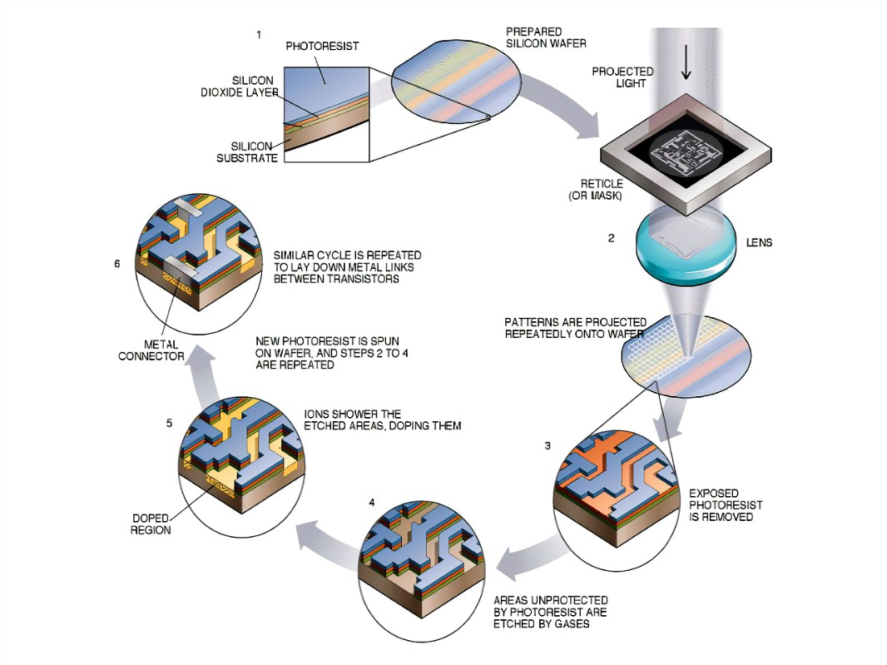
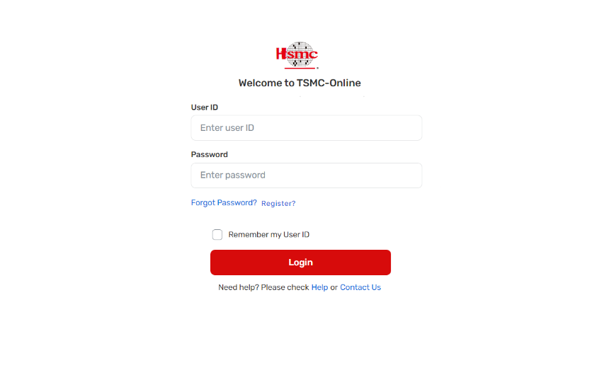
Is these your concerns?
What do we offer?
Information gap of plants
Waste of time and budget
Troubles in payment
Information of 200 plants
Auto-test for your decision
Convenient payment with bank account

Slide 5
1 Data Flow – Check the desicion
Front-end
Analysis
Order
Check
Customer
Return score
Show score
Back-end
Analysis

Slide 6
1 Data Flow – Check chip/order status
Front-end
Status
check
Main Database
Get request
Customer
Show status
MySql check
Return status
Back-end

Slide 7
1 Data Flow – commit order
Front-end
Main Database
confirm
post request
Back-end
Insert order
Return order ID
Customer
Show order ID
Payment status
Bank
Database
payment

Slide 8
02
START
System Front-End and Back-end

Slide 9
Real-time Demonstration

Slide 10
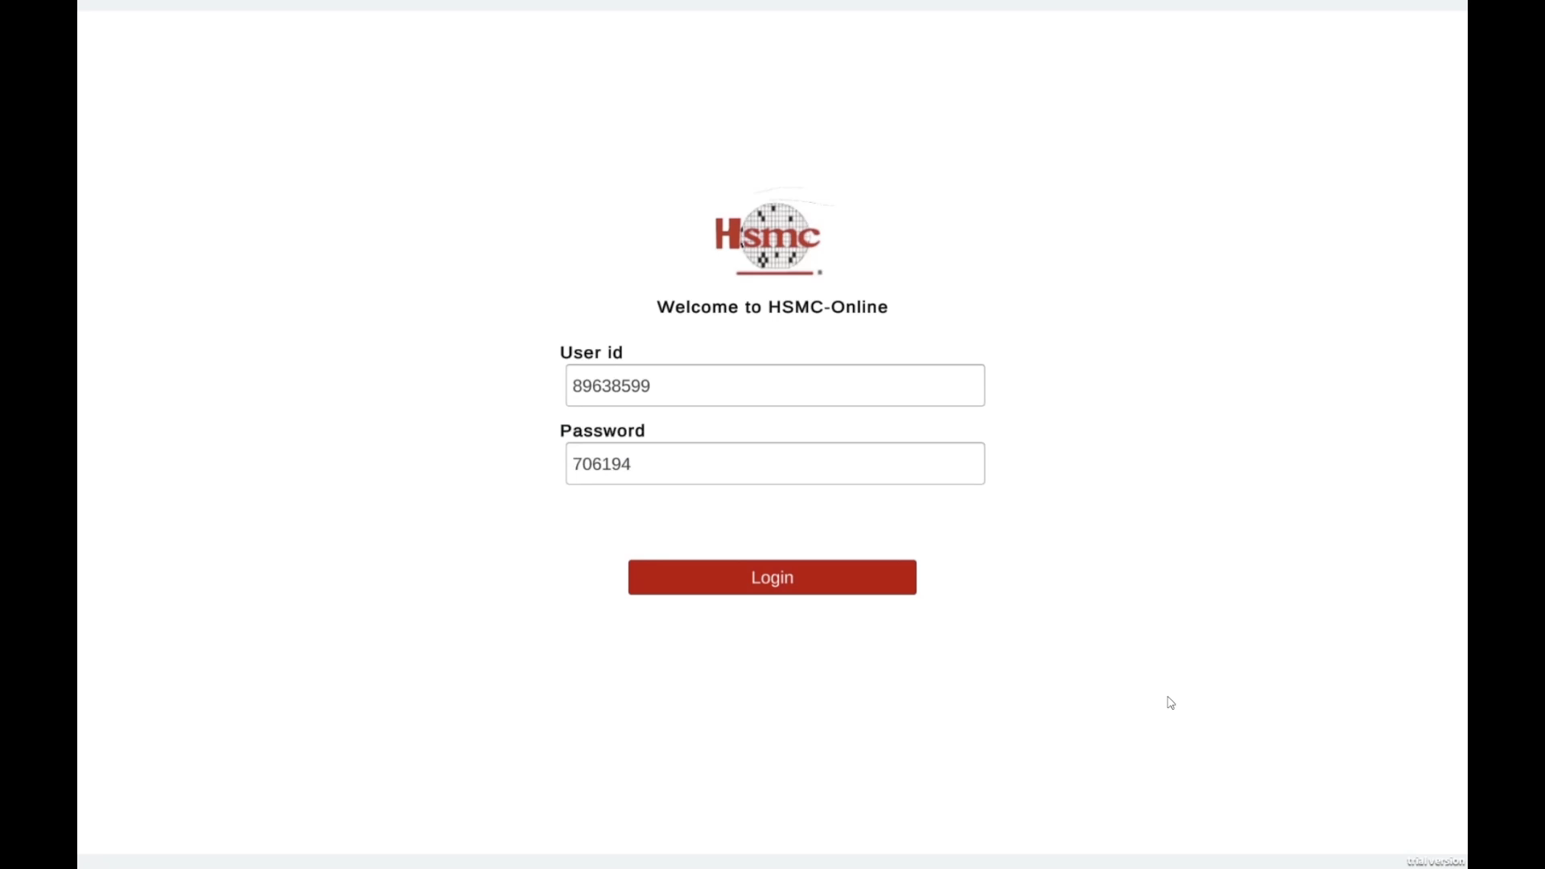

Slide 11
Interface-get
Bank database
Account ID
Front-end
flask
Plant process
Chip process
Main database
Order record

Slide 12
Interface-post
Bank database
Account ID
Payment
Main database
flask
Check login
Front-end
confirm
Plant & order info
KPI
Analysis

Slide 13
03
START
Database Design

Slide 14
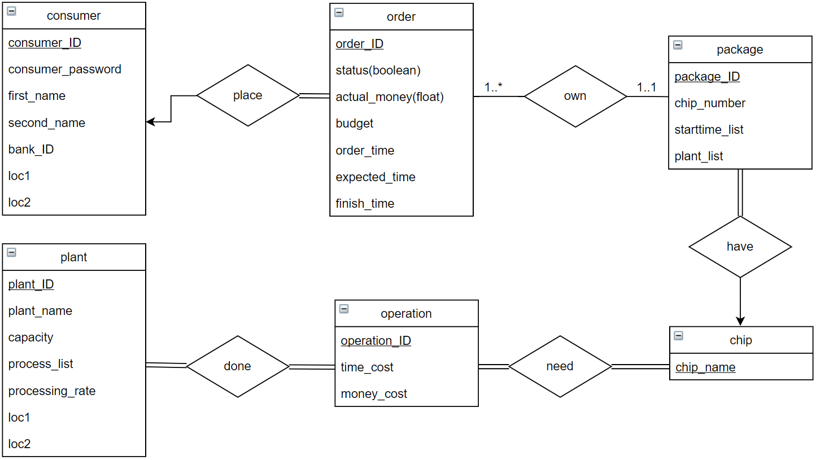
ER Diagram of main database

Slide 15
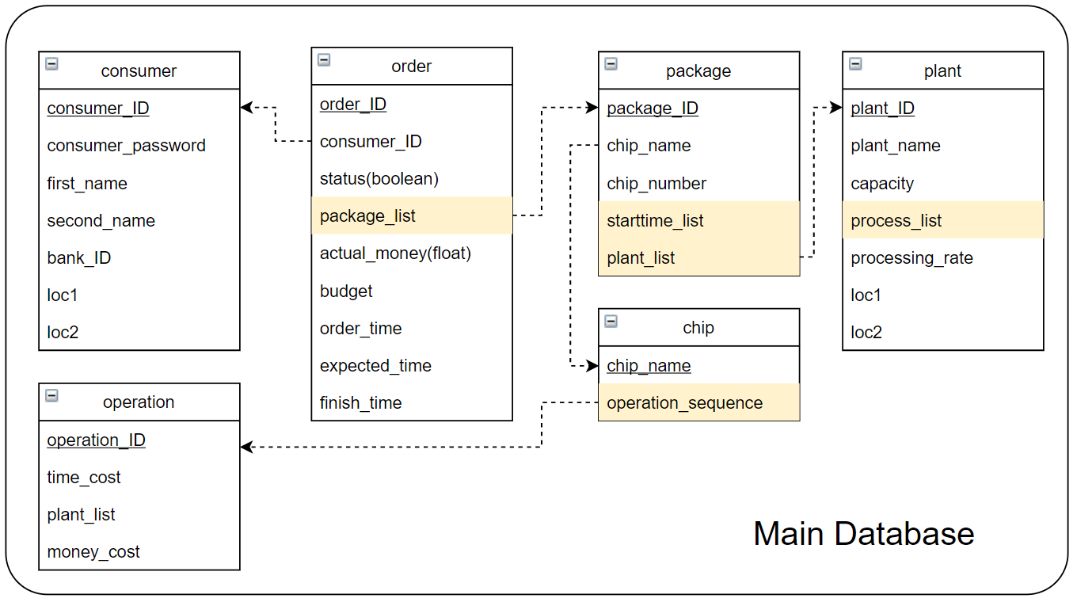
Relation Schema of databases
Bank Database
Bank
Account_ID
Account_Balance

Slide 16
3 System back-end
Why no foreign key and normalization?
For the sake of the analysis and the front end!
No need for natural join
No need for foreign constraint

Slide 17
04
START
Target Analysis

Slide 18


Target Analysis 5
Plants’ appointment
order
Production
plan
Chip information
Main
Database
Customer

Slide 19
Target Analysis 5
Extract real-time data
Score by the distributions
Process
KPI
1
2
3
4
Simulate legal plans in different portfolios
Weight expense and processing time

Slide 20
Simulation
Target Analysis 5
check
check
check
Randomly choose a type of chip i
chosen plant
gap
chosen plant
gap
…
Operation i1
Operation i2
check
check
check
Randomly choose another chip k
chosen plant
gap
chosen plant
gap
…
Operation k1
Operation k2
…

Slide 21
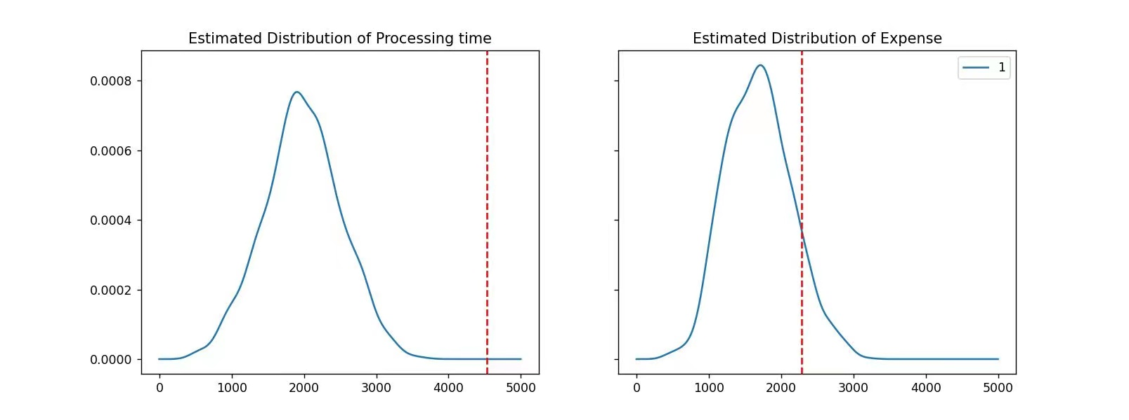
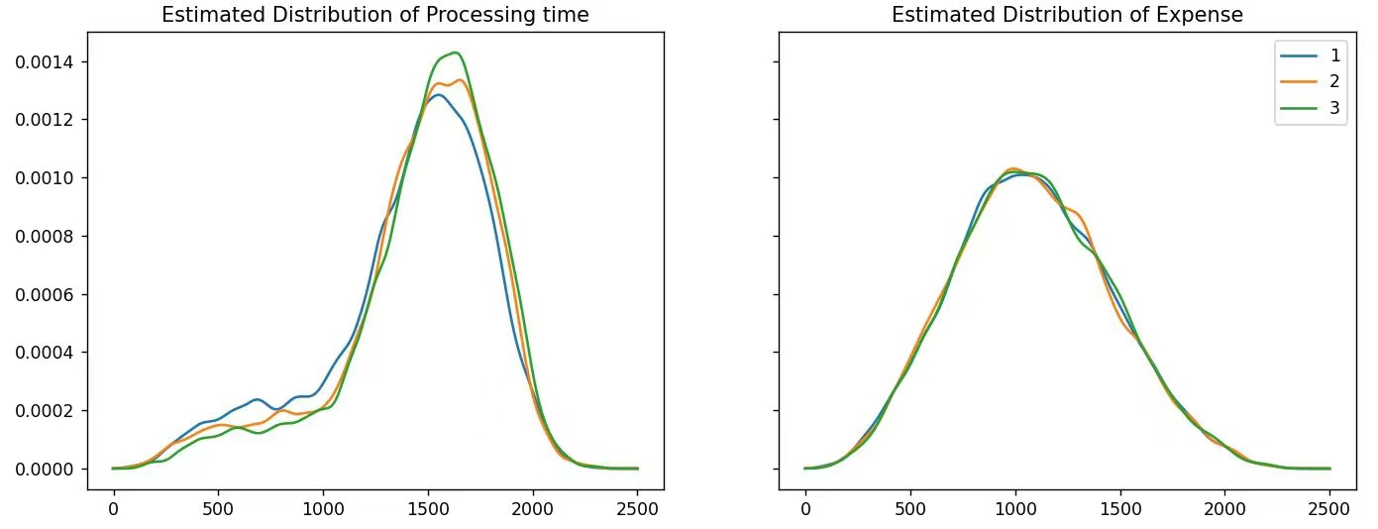
Target Analysis 5
Legal Plan Distribution
Utilization of Kernel Density Estimation (KDE)

Slide 22
2022
Thanks For Listening
END

